Slide 1

Automated Detection and Classification of Leaf Diseases in Black Gram Using Deep Learning Techniques
B.Sc. Final-Defense

Slide 2
Outline
Introduction
Objective
Background Study
Gap Analysis
Methodology
Results & Analysis
Novelty of the Work
Sample Dataset & Expected Output
Web Interface
Conclusion
References
B.Sc. Final-Defense

Slide 3
Introduction
Black gram is an important pulse crop in South Asia, including Bangladesh, valued for its nutritional benefits, soil fertility improvement, and economic importance. However, diseases like Yellow Mosaic Virus (YMV), Cercospora Leaf Spot, Leaf Crinkle, Anthracnose, and Powdery Mildew significantly reduce yield and quality.
Traditional detection methods rely on farmers or experts visually inspecting leaves, which is slow, subjective, and often inaccurate in real farming conditions.
Recent research shows that Deep Learning, especially Convolutional Neural Networks (CNNs), can detect plant diseases from images with high accuracy. However, many existing models are large, require high computing power, and are not suitable for rural areas with limited internet and hardware resources.
This research develops a lightweight CNN model for detecting five types of black gram leaf diseases using a custom, expert-labeled dataset collected from fields in Bangladesh. The dataset was preprocessed using resizing, CLAHE contrast enhancement, and normalization, and balanced through data augmentation.
B.Sc. Final-Defense

Slide 4
Objective
To create a quality and expert-labeled field dataset (IDBGL) of Black Gram leaf diseases.
To preprocess and augment images to enhance the model generalization in the real-life conditions.
In order to compare and train five CNN architectures with transfer learning.
To determine the performance of models based on Accuracy, Precision, Recall, F1-score, ROC-AUC, and MCC and determine the most efficient model.
B.Sc. Final-Defense

Slide 5
Background Study
Authors (Year) | Model Used | Dataset | Key Contribution
Hajare & Rajawat (2025) | Ensemble (DBN + RNN + CNN) with SIDMO | Black gram leaf images | Achieved 94.82% accuracy; ensemble improved performance but was computationally expensive.
Jyothi & Prasad (2025) | VGG + CLAHE + Watershed + DTA | Black gram plant images | Achieved 99.78% accuracy; strong feature extraction for Cuscuta detection.
Talasila et al. (2025) | DeepLabv3+ + EfficientNet-B0 | Real-field black gram images | High segmentation and classification accuracy (99.72%); suitable for field use.
Sangar & Rajasekar (2025) | Wavelet-based AttentionNet + SVM | Black gram leaf dataset | Achieved 99.50% accuracy; robust but computationally heavy model.
Sharma & Kumar (2024) | Hybrid CNN–Transformer | Black gram disease dataset | Achieved 99.56% accuracy; very high performance but complex architecture.
Hajare & Rajawat (2025) | Ensemble (DBN + RNN + CNN) with SIDMO | Black gram leaf images | Achieved 94.82% accuracy; ensemble improved performance but was computationally expensive.
B.Sc. Final-Defense

Slide 6
Gap Analysis
Models achieve high accuracy in lab datasets but fail in real-field conditions.
Lack of early-stage disease and severity level detection.
Lack of strong evaluation techniques, such as MCC, ROC-AUC, and proper cross-validation, making results less reliable.
Segmentation methods struggle with low contrast or overlapping leaves.
Augmentation cannot replicate true environmental diversity.
Minimal integration with real-time farmer feedback or IoT systems.
B.Sc. Final-Defense

Slide 7
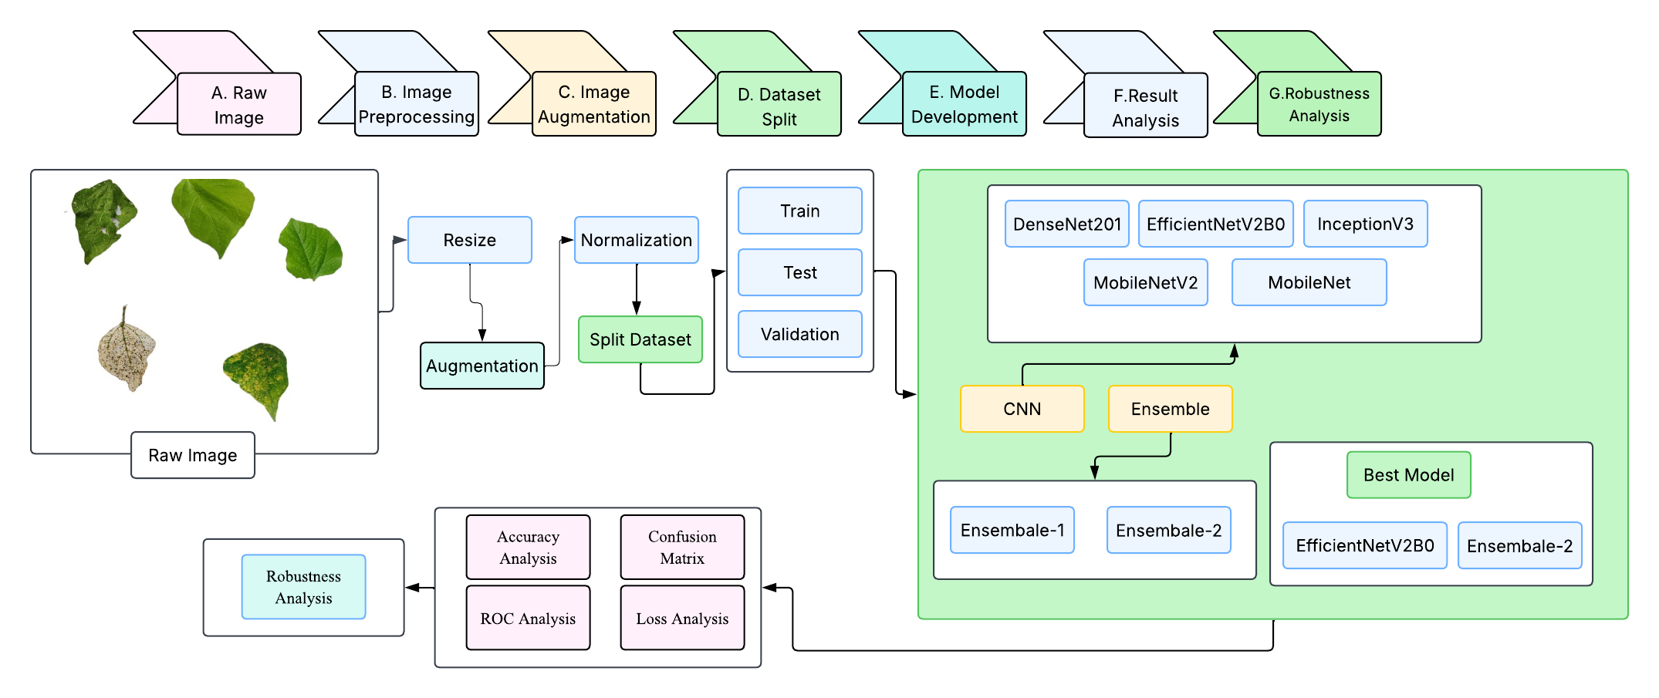
Methodology
B.Sc. Final-Defense

Slide 8
Result and Analysis
CNN Model Result:
Model | Accuracy (%) | Precision (Macro) | Recall (Macro) | F1-score (Macro) | ROC-AUC (Macro) | MCC (Macro)
MobileNetV2 | 98.88 | 0.9889 | 0.9888 | 0.9888 | 0.9998 | 0.9860
MobileNet | 99.08 | 0.9909 | 0.9909 | 0.9908 | 0.9998 | 0.9885
InceptionV3 | 99.08 | 0.9908 | 0.9908 | 0.9908 | 0.9997 | 0.9885
DenseNet201 | 99.34 | 0.9934 | 0.9934 | 0.9934 | 1.0000 | 0.9918
EfficientNetV2B0 | 99.54 | 0.9954 | 0.9954 | 0.9954 | 1.0000 | 0.9943
B.Sc. Final-Defense

Slide 9
Result and Analysis
Ensemble Model Result:
Model | Accuracy (%) | Precision (%) | Recall (%) | F1-score (%) | ROC-AUC | MCC (%)
Ensemble (DenseNet201 + EfficientNetV2B0) | 99.67 | 99.67 | 99.67 | 99.67 | 1.0000 | 99.59
Ensemble (DenseNet201 + EfficientNetV2B0 + InceptionV3) | 99.47 | 99.48 | 99.47 | 99.47 | 99.93 | 99.34
B.Sc. Final-Defense

Slide 10
Result and Analysis
Model | Classes | Precision | Recall | F1-Score | Support
Ensemble-2 (D201 + Ev2B0) | Cercospora Leaf Spot | 1.0000 | 0.9902 | 0.9951 | 305
 | Healthy | 0.9902 | 1.0000 | 0.9951 | 302
 | Insect | 0.9968 | 1.0000 | 0.9984 | 307
 | Leaf Crinkle | 0.9967 | 0.9934 | 0.9951 | 305
 | Yellow Mosaic | 1.0000 | 1.0000 | 1.0000 | 300
 | Accuracy |  |  | 0.9967 | 1519
 | Macro Avg | 0.9967 | 0.9967 | 0.9967 | 1519
 | Weighted Avg | 0.9967 | 0.9967 | 0.9967 | 1519
B.Sc. Final-Defense

Slide 11
Result and Analysis
Cross Validation Result Of Ensemble Model:
Model | Fold-1 | Fold-2 | Fold-3 | Fold-4 | Fold-5 | Main Model
Accuracy | 99.34% | 99.01% | 99.26% | 99.18% | 99.34% | 99.67%
The cross-validation results of the ensemble model show highly stable performance, with accuracy ranging from 99.01% to 99.34% across all five folds.
The final main model accuracy of 99.67% indicates that the ensemble approach further enhanced the overall effectiveness of the model.
B.Sc. Final-Defense

Slide 12
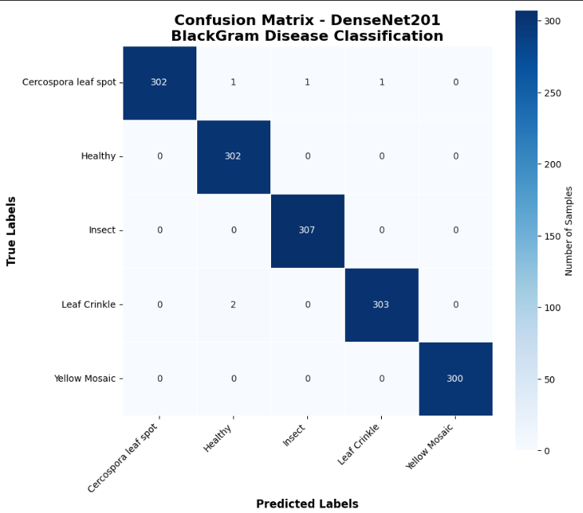
Result and Analysis
Confusion Matrix of Ensemble Model
The diagonal dominance in the matrix indicates that the model correctly classifies the majority of samples for each class.
Misclassifications are extremely low (only 1 or 2 samples), showing the model’s high precision and recall.
Diseases such as Cercospora Leaf Spot, Insect Damage, Leaf Crinkle, and Yellow Mosaic show almost 100% correct predictions.
Overall, the model demonstrates excellent generalization and reliable class separation across all categories.
B.Sc. Final-Defense

Slide 13
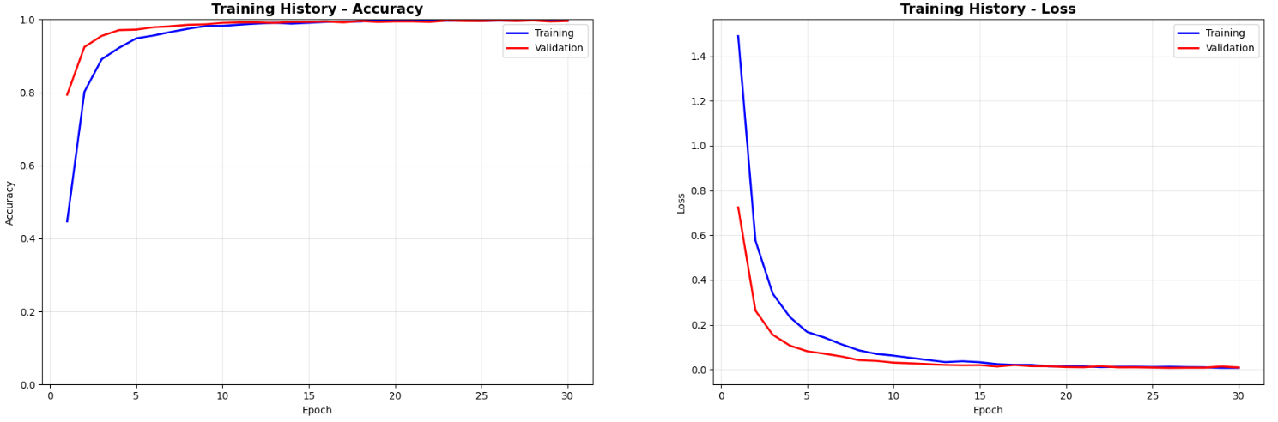
Result and Analysis
Training and Validation Accuracy & Loss of Ensemble Model
The model achieves rapid improvement in accuracy during the first few epochs, followed by stable convergence.
Validation accuracy closely follows the training curve, which indicates strong generalization capability.
Training and validation loss show a steep decline early on, continuing to reduce gradually and stabilizing at a low value.
The absence of divergence between the curves suggests that the model is not overfitting and has learned the feature space effectively.
B.Sc. Final-Defense

Slide 14
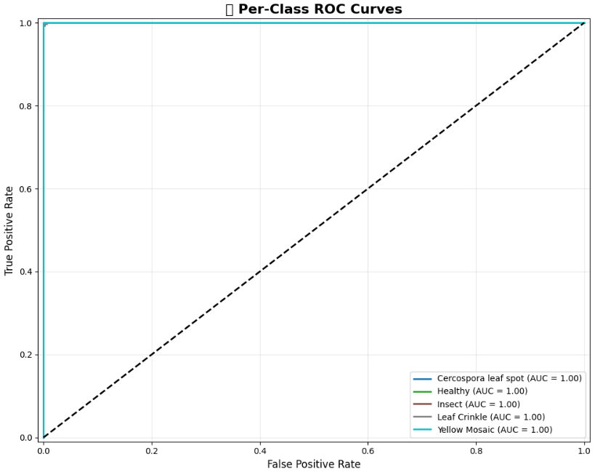
Result and Analysis
Roc Curve of Ensemble Model
The ROC curves of all five classes almost perfectly align with the top-left boundary, leading to an AUC of 1.00 for each class.
Such performance indicates perfect discrimination, where the model consistently classifies positive and negative samples correctly.
The absence of deviation from the ideal ROC line confirms high sensitivity, specificity, and generalization strength.
This level of performance suggests that the learned features are highly reliable for disease detection.
B.Sc. Final-Defense

Slide 15
Novelty of the Work
A new combined model (Ensemble of DenseNet201 + EfficientNetV2B0) is used, which gives much better accuracy than using a single model.
The two models work together and learn different types of features, making the disease detection more correct and stable.
This approach reached 99.67% accuracy, which is higher than previous methods in similar tasks.
The model is designed to work well even when leaf images have noise, blur, or different lighting conditions.
B.Sc. Final-Defense

Slide 16
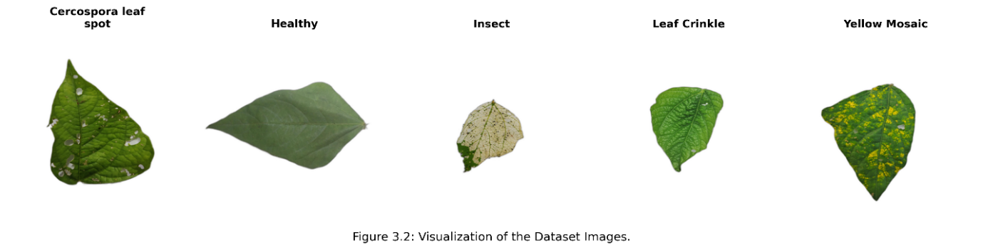
Sample dataset
The IDBGL dataset was created specifically for this research using real-field Black Gram leaf images. A total of 3,057 images were collected from agricultural fields in Sirajganj Sadar and Solonga, Bangladesh during September to November 2024. Images were captured using seven different smartphones to ensure variation in lighting and background conditions. All images were expert-annotated into five classes: Healthy, Cercospora Leaf Spot, Leaf Crinkle, Insect Damage, and Yellow Mosaic Virus. The dataset is publicly available on Mendeley Data for reproducibility.
B.Sc. Final-Defense

Slide 17
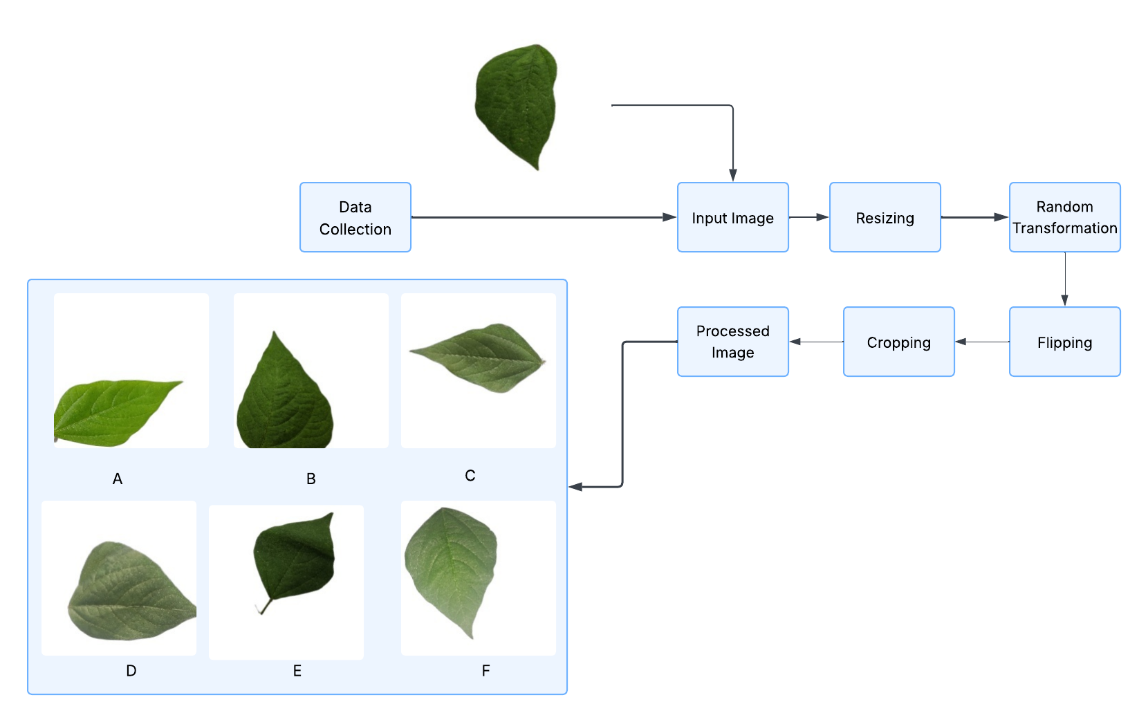
Sample dataset and Expected output
B.Sc. Final-Defense

Slide 18
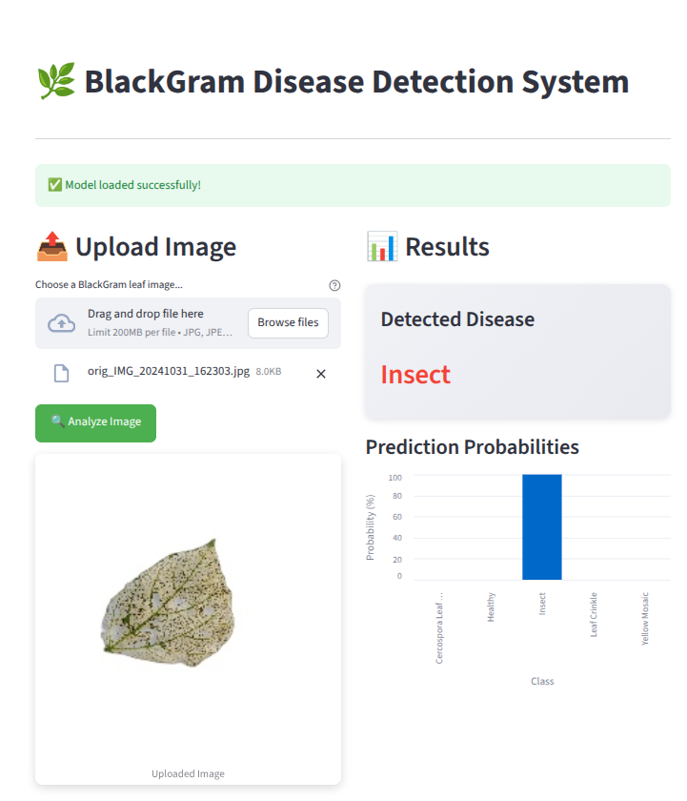
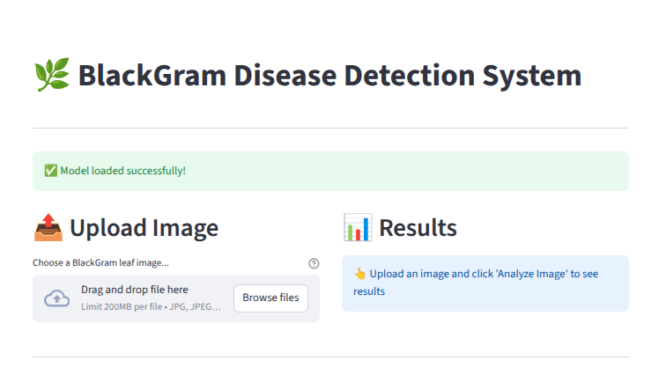
Web Interface of Image Enhancement
B.Sc. Final-Defense

Slide 19
Conclusion
Developed a deep learning–based system for automated black gram leaf disease detection.
Used real-field images collected from Bangladesh for model training and evaluation.
A total of 3,057 expert-annotated images were used in this study.
Multiple CNN architectures were trained and evaluated.
EfficientNetV2B0 achieved the highest accuracy of 99.54%.
DenseNet201 showed strong stability and generalization performance.
The DenseNet201 + EfficientNetV2B0 ensemble delivered the best performance with 99.67% accuracy, offering the most robust and reliable disease classification.
The system proves deep learning can provide accurate and reliable disease diagnosis for farmers.
B.Sc. Final-Defense

Slide 20
References
N. Hajare and A. S. Rajawat, "Black gram disease classification via deep ensemble model with optimal training," International Journal of Image and Graphics, vol. 25, no. 04, p. 2550033, 2025.
N. S. Jyothi and R. S. Prasad, "Cuscuta detection and classification of blackgram plant leaf diseases using deep-transformation algorithm," in 2025 International Conference on Multi-Agent Systems for Collaborative Intelligence (ICMSCI), Jan. 2025, pp. 1854–1858.
S. Talasila, V. K. Gurrala, and R. P. Somineni, "Semantic Segmentation and Transfer Learning based Disease Classification in Black Gram Plants: BLACK GRAM PLANT LEAF SEGMENTATION AND DISEASE CLASSIFICATION," Journal of Scientific & Industrial Research (JSIR), vol. 84, no. 04, pp. 399–410, 2025.
R. Mehta, P. Kumar, G. Prem, S. Aggarwal, and R. Kumar, "Leveraging Artificial Intelligence for Disease Diagnosis in Agricultural Crops: A Review," Indian Journal of Agricultural Research, vol. 59, no. 5, 2025.
P. Das et al., "Characterization of Newly Identified Mung Bean [Vigna radiata (L.) Wilczek] Landraces for Yellow Mosaic Disease Resistance Using Morphological, Biochemical and Molecular Traits," Plant Molecular Biology Reporter, pp. 1–14, 2025.
G. Sangar and V. Rajasekar, "An optimized attention-based deep learning model for black gram leaf disease classification," Journal of Theoretical and Applied Information Technology, vol. 103, no. 4, 2025.
B.Sc. Final-Defense

Slide 21
THANK YOU
B.Sc. Final-Defense

